Slide 1
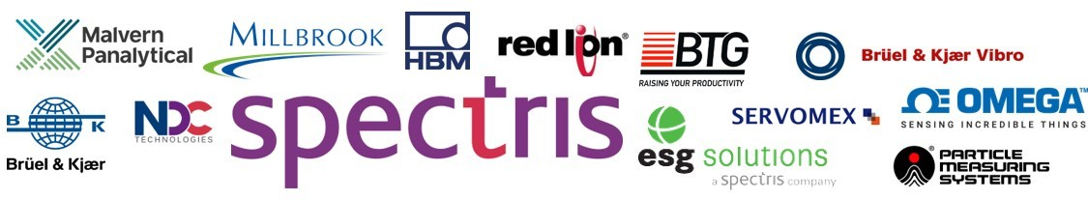
Spectris
A Detailed Company Profile

Slide 2
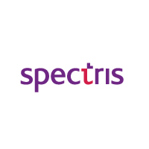
Spectris- Company Overview
Business Overview
Company Key Facts
Spectris plc is a leading supplier of productivity-enhancing instrumentation and controls. They provide solutions combining hardware, software and related services for some of the most technically-demanding industrial applications
The Company’s products, technologies and services help customers to improve product quality and performance, improve core manufacturing processes, reduce downtime and wastage and reduce time to market.
Its global customer base spans a diverse range of end-user markets. Spectris operates across four business segments : Materials Analysis, Test and Measurement, In-line Instrumentation and Industrial Controls
The company is organized as follows:
Test Services - Millbrook Proving Ground
Materials Analysis - Malvern Instruments, Particle Measuring Systems, PANalytical
Test and Measurement - Brüel & Kjær Sound & Vibration, ESG Solutions, HBM Test and Measurement
In-line instrumentation - Brüel & Kjær Vibro, BTG, NDC Technologies, Servomex
Industrial Controls - Red Lion Controls, Omega Engineering
Founding year | 1915, Surrey,UK
Headquarters | Egham, Surrey, UK
Industry | Instrumentation
Stock Exchange Ticker Symbol | LSE: SXS
Company Type | Public
Financial Metrics, 2018
Revenue
Operating
Income
Net Income
£1,604.2 million
£176.4 million
£185.2 million

Slide 3
Executive Management Team
Name | Position | Date appointed
Andrew Heath | Chief Executive | Sep 2018
Mark Fleiner | Business Group Director | Jan 2019
Andrew Harvey | Group Human Resources Director | Jan 2017
Eoghan O’Lionaird | Business Group Director | Feb 2014
Ken Smith | Asia Pacific President | Jul 2012
Mark Serföző | General Counsel & Company Secretary | Nov 2017
Robin Stopford | Group Head of Corporate Development | Nov 2013
Derek Harding | Chief Financial Officer | Mar 2019

Slide 4

Spectris: Key Strategies to strengthen the brand
Increase presence in strategic markets
Leadership positions in attractive markets where there are ample opportunities for technology led productivity enhancement.
Expand presence in strategic markets such as pharmaceuticals/life-sciences, basic materials, energy, automotive and technology.
Focus on innovative customer solutions:
Increasing focus on solutions involving the provision of software, hardware and services.
Product innovation based on thorough understanding of businesses and productivity challenges.
Accelerate operational excellence:
Enhance customer experience through efficiency and productivity gains.
Improve performance and profitability across the globe.
Strive for continuous improvement in all aspects.
Expand Business globally
Geographical expansion of newly acquired businesses and customer base.
Seek to expand geographical operations of newly acquired businesses.
Deploy capital for both platform and bolt-on M&A
New platform businesses in identified strategic markets or complementary capabilities.
Bolt-on acquisitions to broaden customer offering, reach new customer segments or expand geographical presence.

Slide 5
Spectris: Key Investment attributes
Segment 1
High barriers to entry supported by continuous innovation and long-term customer relationships
Strong intellectual property and continuous innovation, underpinned by sustained investment of around 6-7% of sales each year in research and development and by frequent bolt-on acquisitions.
Long-term customer relationships, result in high levels of repeat business (over 80% of sales in any one year are generated from customers who have purchased from the company within the last two years)
Application expertise: Company employees have in-depth know-how and expertise in their chosen fields.
High gross margins, supported by a stable pricing environment.
Focus on customer solutions in attractive markets with strong growth potential ›
Enhancing productivity for customers is an ever-present growth driver for all of our businesses.
Increasingly focused not just on the supply of equipment but on the provision of innovative customer solutions, involving services, software and related activities.
The company is also focused on exploiting disruptive growth themes to enhance their growth prospects.
Segment 2
Segment 3
Broad geographical and end-market exposures, 40% of sales generated from customer operating expenditure budgets
Broad spread of customers, end markets and geographies limits the risk to the Group from adverse changes in any single geography or end market.
40% of sales generated from customer operating expenditure budgets or aftermarket sales.

Slide 6
Spectris: Key Investment attributes
Segment 4
Strong cash conversion resulting from asset-light manufacturing model
Majority of manufacturing is outsourced, resulting in low capital requirements for their businesses.
High gross margins and low capital requirements result in strong operating cash conversion.
Segment 5
Balance sheet strength enabling progressive dividend policy
Strong cash conversion enables the company to sustain a progressive dividend policy while maintaining a strong balance sheet.
Investments evaluated on cash flow return on invested capital basis, measuring return on investment against weighted average cost of capital.
Strong cash conversion and balance sheet ensure considerable financial firepower and flexibility to fund acquisitions.
Segment 6
Proven acquisition model to supplement organic growth
Acquisitions have been a key component of the firm’s growth strategy for many years; typically bolt-on in nature, occasionally stand-alone operating companies.
The existing markets continue to offer significant opportunities, while the company also considers acquisitions as a way of exploiting disruptive growth themes.

Slide 7
Key Acquisitions & Disposals
Acquisitions have been a key component of the company’s growth strategy, supplementing organic growth across all of their business segments
Sysmex Delta-F N-Tron
Sysmex Delta-F N-Tron
Reologica Om Sysmex Delta-F N-Tron
Microscan
LVS Sound
IRM SixNet Omega
Fusion
ReliaSoft Spectraseis
LVS
Sound Answers
Setpoint CSA Leyland Omnicon
Naneum Nanosight
2010 2011 2012 2013 2014 2015 2016 2017 2018
Claisse
MicroCal
Affinity Biosensors FiberSensing
ESG Solutions
CAS Capstone SVT
Discom Millbrook
Concept Life Sciences Revolutionary Engineering
VI-grade
Omec Sysmex Delta-F N-Tron
Reologica Omec
Sysmex Delta-F N-Tron
a Sysmex Delta-F N-Tron
ASD
NoViSim DCM
EMS B & K
EMS B & K Disposal has gone into a joint venture with Macquarie Capital
Disposals
Acquisitions

Slide 8
Sales data

Slide 9
Business Segments- Sales data 2018
Laboratory Businesses
MATERIAL ANALYSIS
Products and services that enable customers to determine structure, composition, quantity and quality of particles and materials, during their research and product development processes, when assessing materials before production, or during the manufacturing process. Integrated drug discovery, development and analytical services.
Sales | £541.1m
Adjusted Operating Profit | £95.4m
Adjusted Operating Margin | 17.6%
% Group Sales | 34%
Industries:
Metals, minerals & mining Pharma & fine chemicals Academic research Semicon, telecoms & electronics
Operating companies
Malvern Panalytical
Particle Measuring Systems
Concept Life Sciences

Slide 10
Business Segments- Sales data 2018
Laboratory Businesses
TEST & MEASUREMENT
Test, measurement, analysis and validation equipment, software and services for product design optimisation, manufacturing control and microseismic monitoring. Automotive Aerospace Electronics Energy Academic research
Sales | £522.6m
Adjusted Operating Profit | £67.2m
Adjusted Operating Margin | 12.9%
% Group Sales | 33%
Industries:
Automotive Aerospace Electronics Energy Academic research
Operating companies:
Brüel & Kjær Sound & Vibration
ESG Solutions
HBM
Millbrook
VI-grade

Slide 11
Business Segments- Sales data 2018
Process/Manufacturing Businesses
IN-LINE INSTRUMENTATION
Process analytical measurement, asset monitoring and on-line controls as well as associated consumables and services for both primary processing and the converting industries.
Sales | £312.2m
Adjusted Operating Profit | £42.6m
Adjusted Operating Margin | 13.6%
% Group Sales | 19%
Industries:
Process industries Energy & utilities Pulp, paper & tissue Web & converting
Operating companies:
Brüel & Kjær Vibro
BTG
NDC Technologies
Servomex

Slide 12
Business Segments- Sales data 2018
Process/Manufacturing Businesses
INDUSTRIAL CONTROLS
Products and solutions that measure, monitor, control and inform during the production process.
Sales | £228.3m
Adjusted Operating Profit | £43.1m
Adjusted Operating Margin | 18.9%
% Group Sales | 14%
Industries:
Manufacturing Process industries Energy Electronics
Operating companies:
Omega Engineering
Red Lion Controls

Slide 13
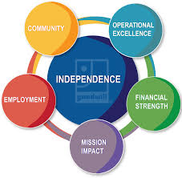


Strategic initiatives 2018, IT investments & initiatives
Invested £103.4 million in R&D (6% of sales).
New product launches: PMS’ Quality Assurance data management system, Malvern Panalytical’s particle characterisation products – the Zetasizer Ultra/Pro systems and Morphologi static imaging systems; and new software products from BKSV and HBM.
Merger of BKSV and HBM to better deliver integrated data solutions to customers
Launched digital solutions brand, Spectris Advance, showcasing the company’s IIoT capabilities in specific end markets, combining instrumentation, connectivity and analytics expertise to provide more cross-group solutions.
Acquired Concept Life Sciences whose activities in integrated drug discovery, development and analytical testing complement their existing instrumentation.
Acquired Concept Life Sciences, which provides integrated drug discovery, development and analytical testing in the pharma and biotechnology sectors which complement the activities of Malvern Panalytical.
Acquisition of Revolutionary Engineering, an automotive test system and service provider in the USA, specialising in driveline test services and solutions. Revolutionary Engineering has been integrated into Millbrook, expanding both Millbrook’s offering to customers and presence in North America. Millbrook also expanded its automotive testing service capacity and capability at both its Finland and UK sites.

Slide 14
Strategic initiatives 2018, IT Investments & initiatives
Acquisition of VI-grade, a leading global provider of vehicle simulation software, systems and services which complements the software and simulation capability of the automotive segment within HBK.
Acquisition of Revolutionary Engineering and VI-grade expands automotive offering with a US presence and in software simulation.
Merger of BKSV and HBM to deliver integrated test, measurement and data solutions to their customers and improve cost efficiencies.
Focus on Lean manufacturing initiatives with Kaizen events held across their businesses to improve on-time delivery, quality and operational efficiency.
Acquisition of Concept Life Sciences, which provides integrated drug discovery, development, analytical testing and environmental consultancy services, as well as development and analytical services for the food, consumer and environmental industries
Group-wide direct and indirect procurement contracts signed, such as freight provision, to harmonise activities and leverage the Group scale to enhance terms.

Slide 15
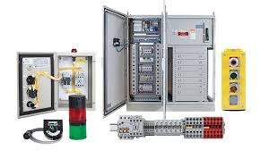
Industrial Controls- IT Investments & initiatives
Industrial Controls operating companies provide products and solutions that measure, monitor, control and inform during the production process. The operating companies in this segment are Omega Engineering and Red Lion Controls.
The increasing emphasis on industrial connectivity and IIoT from the customers is generating opportunities for both Red Lion and Omega.
Red Lion included cloud connectivity to its Crimson software platform, allowing the data collected from industrial devices to be pushed to platforms that include Amazon AWS or Microsoft Azure. This further broadened the company’s market, and has made forays in several key verticals, including energy exploration and alternative energy. The company also added OPC UA functionality, a machine to machine communication protocol for industrial automation, allowing access to data.
Red Lion has also been refreshing its product lines. For example, it launched the DA10D and DA30D protocol conversion and data acquisition devices, providing customers with a cost-effective way of unlocking the value of data contained in legacy equipment.
With user-friendly software, customers can quickly configure communications links to over 300 types of industrial controllers, allowing them to cost-effectively monitor and manage machines Their data collection strategy and secure access to their manufacturing information is increasing demand for these types of products.
The connectivity capability of Omega’s portfolio was similarly expanded with the launch of four product platforms with wireless, ethernet and/or remote connectivity, while also extending the ability of existing platforms to utilise new types of measurement inputs and send data through wireless connections. Omega and Red Lion have begun collaborating to find ways to leverage their digital infrastructure to improvise their product offering to customers

Slide 16
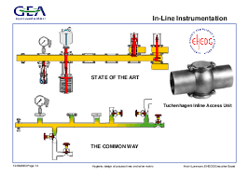
In-Line Instruments: IT Investments & initiatives
In-line Instrumentation operating companies provide process analytical measurement, asset monitoring and on-line controls, as well as associated consumables and services for both primary processing and the converting industries. The operating companies in this segment are Brüel & Kjær Vibro, BTG, NDC Technologies (‘NDCT’) and Servomex.
The Capstone dataPARC analytics offering also continues to be deployed in several process industries, including power generation, chemical, wastewater and ethanol. For instance, a leading Korean utility company is replacing its existing data history with dataPARC across all their generation sites as the real-time data and information gathered through dataPARC is also integrated with the customer’s predictive modelling infrastructure.
Brüel & Kjær Vibro’s wind turbine condition monitoring system provide remote turbine monitoring and diagnostic services.
The wind turbine condition monitoring system provide remote turbine monitoring and diagnostic services as there is demand from various OEMs. It provides more predictive analysis and a more holistic monitoring solution.

Slide 17

Test & Measurement: IT Investments & initiatives
In 2018, HBM & BKSV companies launched new software products which aim to streamline and simplify data acquisition and monitoring: HBM has launched EVIDAS, its next-generation data acquisition and analysis software with cloud integration, and BKSV released BK Connect, a highly innovative sound and vibration software analytics platform.
These platforms help combine seamless data acquisition, monitoring, multiple analysis, data viewing and reporting in the same system. HBM also launched ClipX, a novel miniaturised data acquisition product for industrial applications.
Demand for ESG’s microseismic monitoring solutions increased due to improved conditions in global oil and gas and mining markets and a rising rig count and the launch of new oil and gas and mining projects.
Increased sales of the new microseismic data acquisition, processing and analysis product, FRACMAP® Clarity, and insights for oil and gas customers on the productive fracture network and reservoir coverage and an improved estimate of recoverable resource.

Slide 18
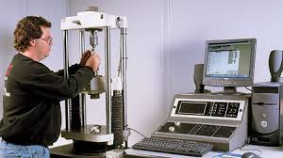
Material Analysis: IT Investments & initiatives
Materials Analysis operating companies provide products and services that enable customers to determine structure, composition, quantity and quality of particles and materials, during their research and product development processes, when assessing materials before production, or during the manufacturing process. The operating companies in this segment are Malvern Panalytical, Particle Measuring Systems (‘PMS’) and Concept Life Sciences.
Several new products were launched by Malvern Panalytical and these included the Epsilon 4 XRF spectrometer, a new high-performance benchtop analytical tool for determining the chemical composition of different materials. It is applicable to industries such as mining, pharmaceuticals and oils/fuels which need to comply with international regulations and test methods.
PMS released the next generation of FacilityPro products which deliver enhanced flexibility to meet the latest environmental monitoring needs whilst ensuring data security and reliability.
Following partnership with Novatek International to provide a fully-integrated software and hardware solution for environmental monitoring, PMS launched the first fully-integrated Quality Assurance data management system for pharmaceutical manufacturers, PharmaIntegrity, to meet regulatory requirements and ensure product integrity.

Slide 19
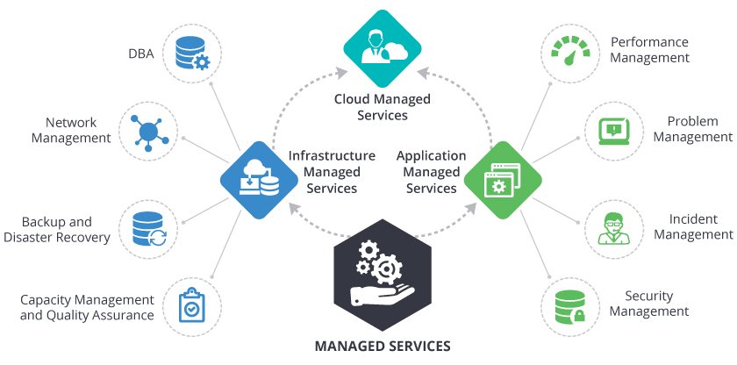
Insights for IT service providers
IT service providers need to manufacture their version of sophisticated software to compete with the software developed and marketed by the company for various industries such as Automotive, pharmaceuticals, test and measurements, manufacturing and so on.
Apart from providing platforms such as Amazon AWS or Microsoft Azure, IT service providers need to manufacture and market their cloud computing platform catering to industrial machines. Various version of more easy-to-use IIoT software analytical packages need to be marketed to future customers.
Thorough understanding of the industrial machinery and the software analytical packages being used are needed for IT service provides to stay in the market competition.
Maintenance and product as a service (PaaS)packages will add more value to any software provided by IT service companies. Regular IT training to companies on the ever-evolving technology will also ensure steady partnership between software service providers and companies.
With the emergence of smart factories(industrial 4.0), the convergence of physical and digital worlds through technology, engineering and manufacturing expertise has become absolutely essential to boost clients’ competitiveness in responding with solutions across product lifecycle value chain.
Connected
Products
Smart
Engineering
Digital
Manufacturing

